Slide 1
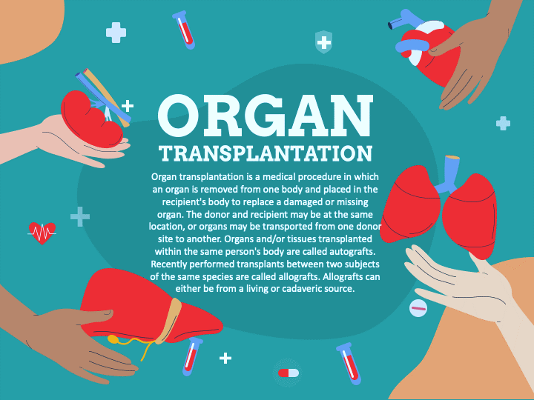
WELCOME

Slide 2

TRANSPLANTUNITY NETWORK
PROJECT SUBMITTED BY:
PRIONTY TARAFDER (2101005)
AYESHA SIDDIKA (21201080)
EFFAT HABIBA (21201086)
HANIA ISLAM (21201121)
AFSANA SIDDIKA (21201122)
PROJECT SUBMITTED TO:
SABIHA TAHSIN SOHA
LECTURER
DEPARTMENT OF CSE.

Slide 3
TransplantUnity Network
"TransplantUnity Network" suggests a network or platform that brings together various stakeholders, including patients, donors, healthcare professionals, and support services, fostering a sense of togetherness in the journey of transplantation. It's a name that can resonate well with the community involved in organ transplants and emphasizes the collaborative aspect of the initiative.
PROJECT DESCRIPTION
The TransplantUnity Network is a comprehensive and specialized component within a Database Management System specifically tailored to the complex and life-saving field of organ transplantation. This network serves as the backbone for the seamless management and coordination of data and processes related to organ transplantation. Within this system, various crucial relationships and data elements are meticulously managed, ensuring that both doctors and patients, as well as hospitals, can operate efficiently and deliver the best possible care to those in need of organ transplants.

Slide 4
Doctors can monitor patient progress,plan surgeries,and communicate with patients and their families through the network.
It maintains a comprehensive database that catalogues patients in need of organs and available donors, creating a vital link that is crucial to the success of transplantation procedures..
Doctor and Patient
Patient and Donor
The TransplantUnity Network manages operation room schedules, surgical procedures, and the status of transplant surgeries.
Operation Room and Surgery
ENTITES
Hospital Area
It tracks the availability of operation rooms, surgical teams, and specialized facilities within hospitals, ensuring that the logistical aspects of transplantation are managed effectively.
Organ
It tracks the origin of the organ, its condition, and its compatibility with potential recipients.
Medical Records
Blood Group
This network maintains up-to-date blood type data for all patients and potential donors, enabling quick and accurate matching
This network maintains up-to-date blood type data for all patients and potential donors, enabling quick and accurate matching

Slide 5
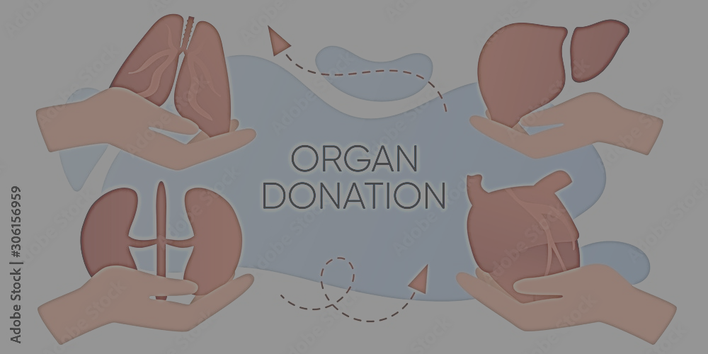
ATTRIBUTES
Donor:
Primary key,
1. donor_ID
2. donor_name
3. donor_age
4. donor_gender
Foreign key,
1. hospital_id
2. genetic_diseases
3. acquired_diseases
4. allergies
5. blood_type
6. rh_facto
Organ: 1. name - Primary key-
2.durability Primary key
HIV :1. name - Primary key
2. organ_name - Foreign key
Donation:1. donor_id - Primary key
2. organ_name - primary key
Doctor:1. doctor_ID - Primary key
2. doctor_name - Primary key
3. hospital_id - Foreign key
4. salary - Foreign key
5. speciality - Foreign key
Blood Group:1. blood_type - Primary key
2. rh_factor - Primary key
Operation Room:1. room_no - Primary key
2. building - Primary key
3. hospital_id - Foreign key
Surgery: Primary key,
name
2. patient_id
Foreignkey, 1. patient_id
2. doctor_id
3. donor_id
4. room_no
5. building
Area:1. name - Primary key
2. code - Primary key
Hospital:1. hospita_ID - Primary key
2. hospital_name - Primary key
3. area_name – foreing key
4. area_code - Foreign key
Medical Record:
Primary key,
genetic_diseases
2. acquired_diseases
3. allergies
Patient:
Primary key,1. patient_ID
2. patient_name
3. patient_age
4. patient_gender rh_factor
Foreign key,
1. damage_name 2.damage_stage
3. hospital_id 4. genetic_diseases
5. acquired_diseases 6. allergies
7. blood_type 8. rh_factor
Consultant:1. patient_id - Primary key
2. doctor_ID - Primary key

Slide 6
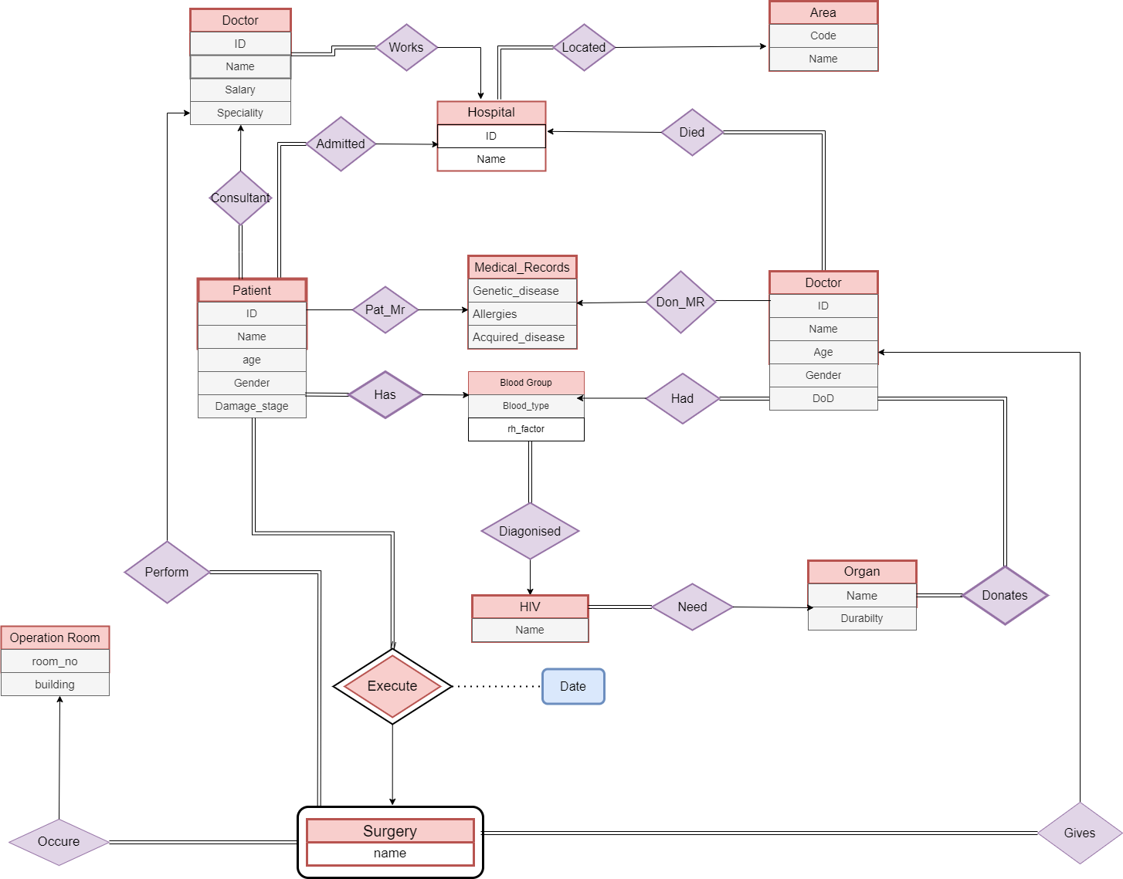
TransplantUnity Network ER Diagram

Slide 7
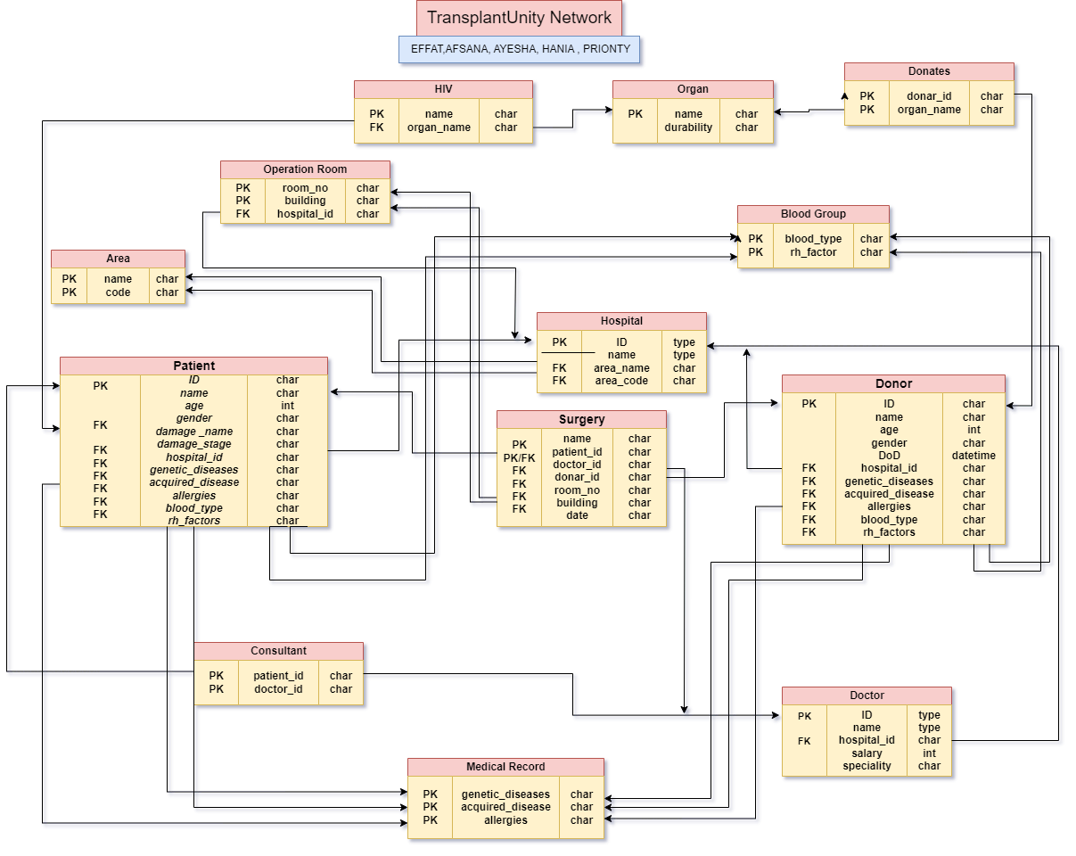
SCHEMA DIAGRAM

Slide 8
Entities and their Relationships (Cardinality):
HIV-Organ(m:1) Need
Hospital-Area(m:1) Located
Patient-Hospital(m:1) Admitted
Patient-Medical Record(m:1) Pat_MR
Patient-Blood Group(m:1) Has
Patient-HIV(m:1) Diagnosed
Donor- Medical Record(m:1) Don_MR
Donor-Hospital(m:1) Died
Donor-Blood Group(m:1) Had
Donor-Organ(m:n) Donates
Doctor-Hospital(m:1) Works
Doctor-Patient(m:n) Consultant
Surgery-Operation Room(m:1) Occur
Surgery-Patient(1:m) Perform

Slide 9
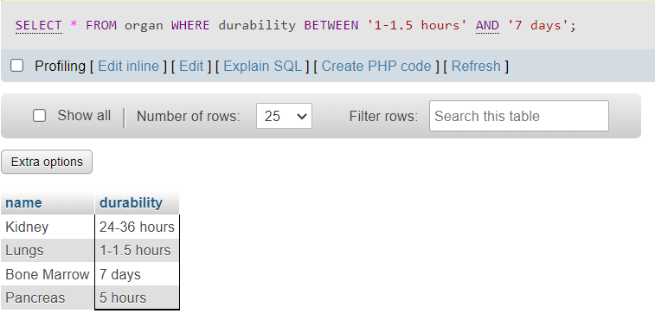
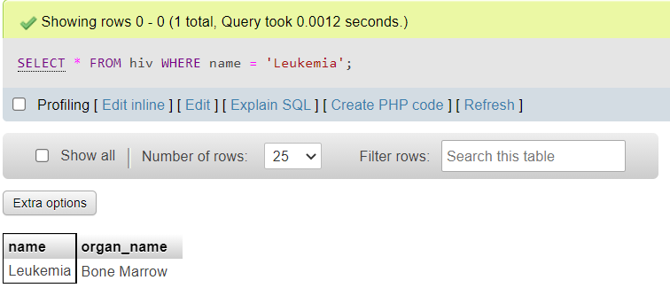
SQL Queries
1.Show all the durability.
Query: SELECT * FROM organ WHERE durability BETWEEN ‘1-1.5 hours ‘ AND ‘7 days’;
2.Find the name Leukemia.
Query: SELECT * FROM hiv WHERE name = ‘Leukemia’;

Slide 10
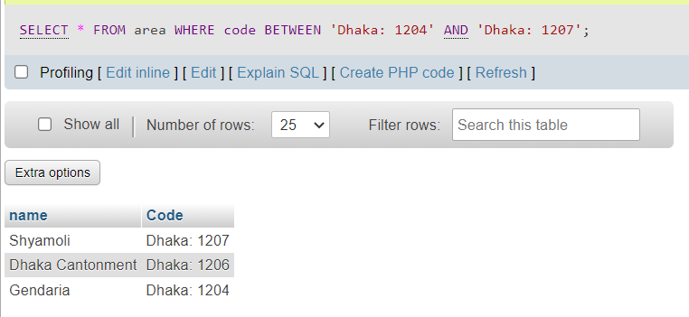
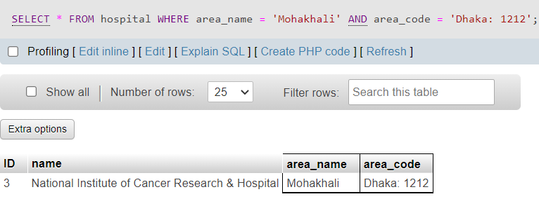
3.Find Code BETWEEN Dhaka: 1204 TO Dhaka: 1207
Query: :SELECTN * FROM area WHERE code BETWEEN ‘Dhaka 1204’ AND ‘Dhaka: 1207’;
4.Find area_name and area_code ‘Mohakhali’’Dhaka:1212’
Query: SELECT * FROM hospital WHERE area_name = ‘Mohakhali’ AND area_code=’Dhaka:1212’;

Slide 11
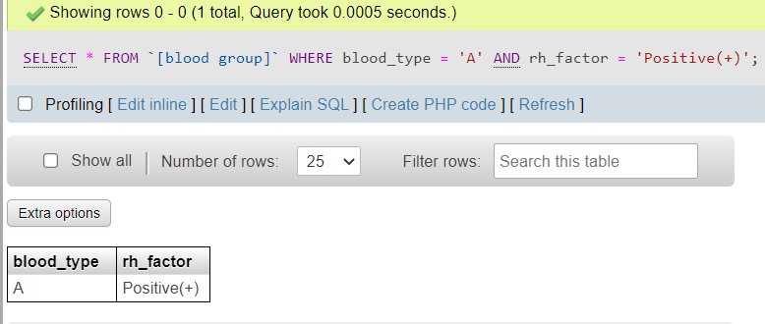
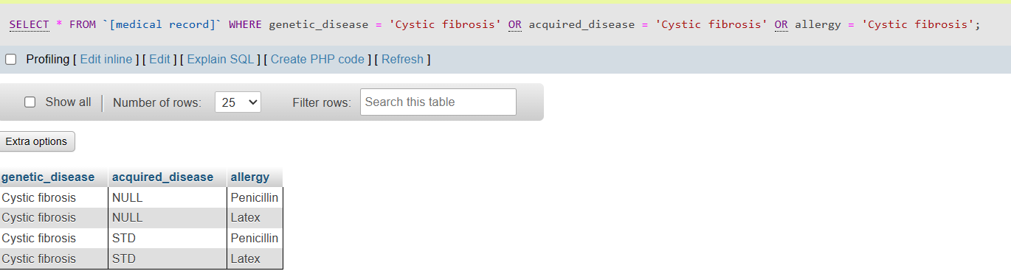
5.Find blood group and blood type ‘A’ ‘Positive(+)’
Query: SELECT * FROM ‘[blood group] WHERE blood_type = ‘A’ AND rh_factor = ‘Positive(+)’;
6.Find Cystic fibrosis in every column.
Query: SELECT * FROM `[medical record]` WHERE genetic_disease = 'Cystic fibrosis' OR acquired_disease = 'Cystic fibrosis' OR allergy = 'Cystic fibrosis';

Slide 12
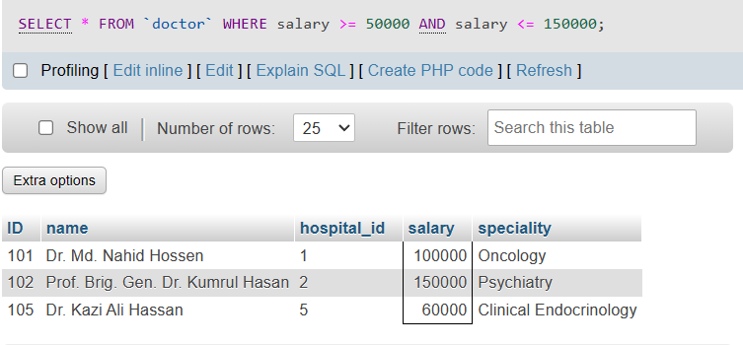
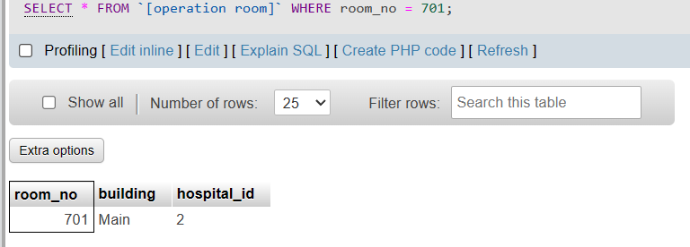
7.Find doctor salary between 50000 to 150000.
Query :SELECT * FROM `doctor` WHERE salary >= 50000 AND salary <= 150000;
8.Find the operation room 701
Query :SELECT * FROM [operation room] WHERE room_no = 701;

Slide 13
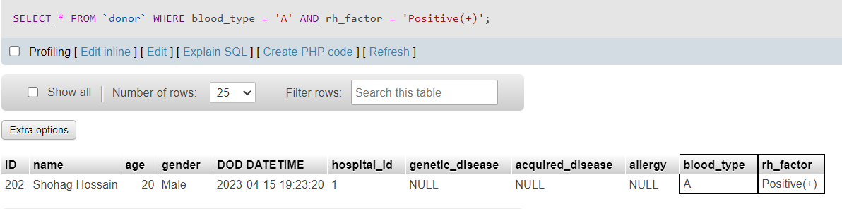
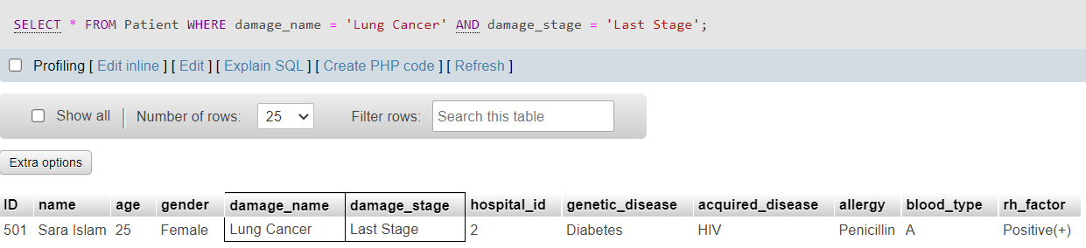
9.Find blood type ‘A’and rh factor Positive(+)
Query: SELECT * FROM donor WHERE blood_type =‘A’ AND rh_factor = ‘Positive(+)’:
10.Find damage name Lung cancer and damage stage Last stage
Query: SELECT * FROM Paitent WHERE damage_name = ‘Lung Cancer’ AND damage_stage = ‘Lung Stage’;

Slide 14
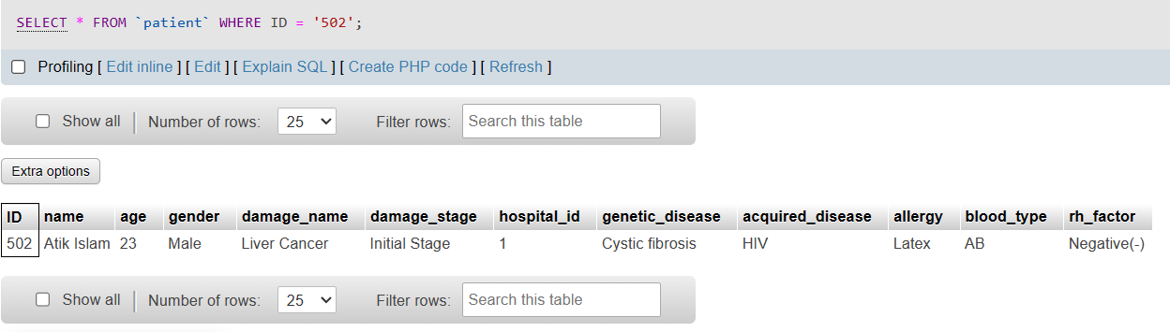
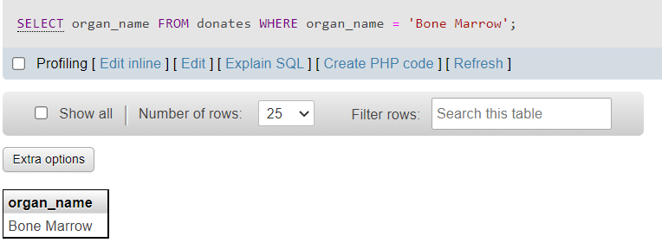
11.Find the ID 502.
Query : SELECT * FROM `patient` WHERE ID = '502';
12.Find organ name Bone Marrow
Query: SELECT organ_name FROM donates WHERE organ_name = ‘Bone Marrow’;

Slide 15
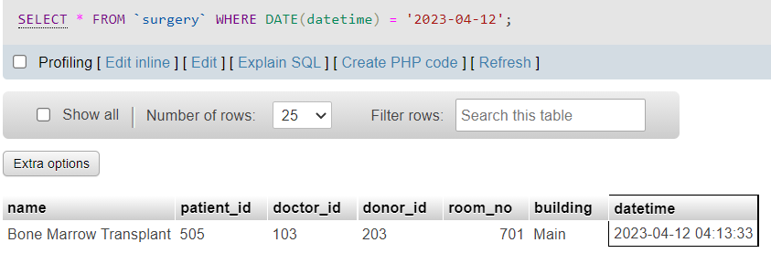
13.Find the Date “2023-04-12”
Qeury: SELECT * FROM ‘surgery’ WHERE DATE(datetime) = ‘2023-04-12’;

Slide 16

THANK YOU

